Slide 1
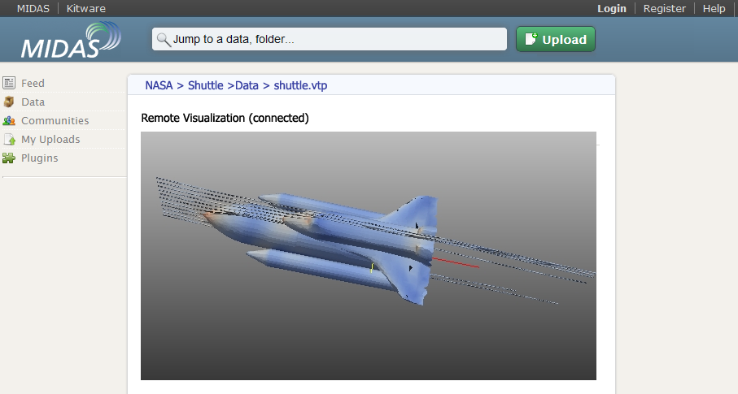
Remote Visualization of Large Datasets with MIDAS & ParaViewWeb
Web3D – Paris 2011
Julien Jomier, Kitware julien.jomier@kitware.com

Slide 2
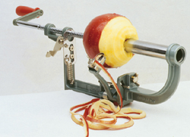
Motivation
Notes:
Use electron microscopy to image tissue samples
~25 μm resolution
100,000 x 100,000 x 40,000 images
Each of the 20,000 images is 10 gigabytes
Total size is for one dataset: terabytes

Slide 3
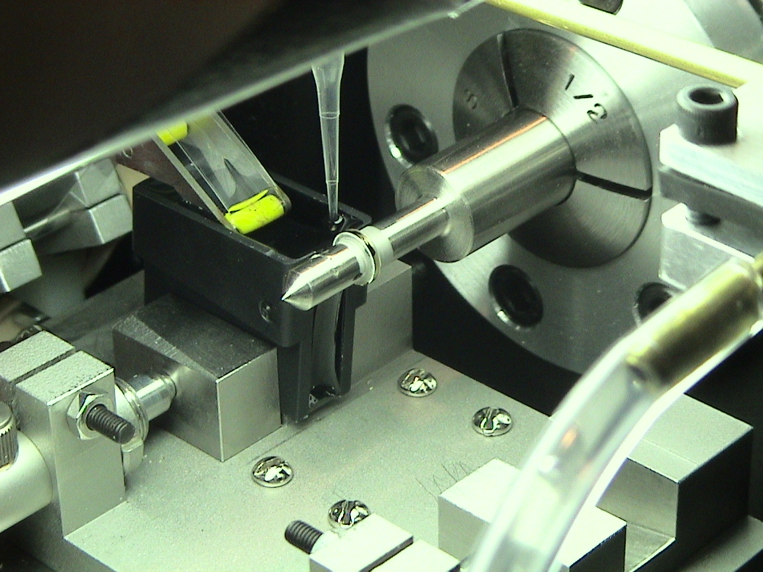
Acquiring Data (2)
This tissue ribbon is collected by a submerged conveyor belt
Knife advances
Tissue rotates
These synchronized motions produce a spiral cut through the tissue block, yielding a continuous ribbon of tissue in the knife’s water boat
Notes:
Embed tissue samples in cylindrical polymer
Produce continuous ribbon of material at high data rates
Image (SEM) ribbon as it streams off

Slide 4
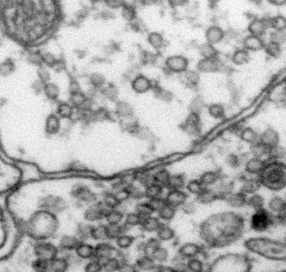
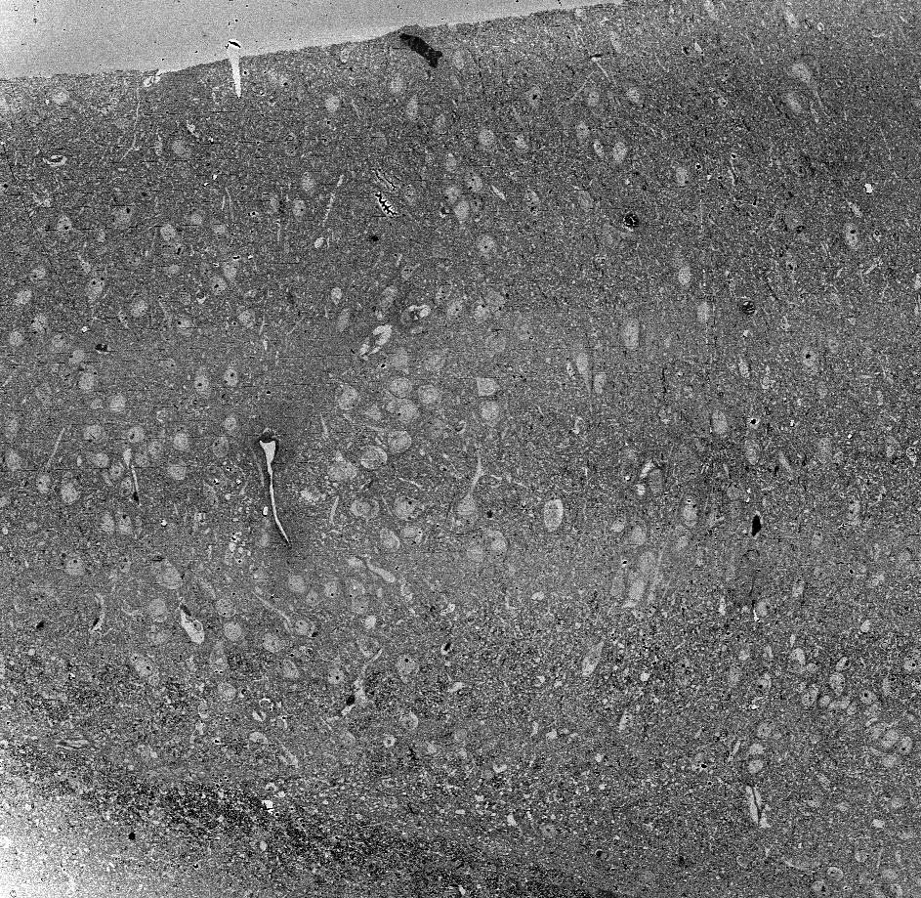
0.1 μm
100 μm

Slide 5
Motivation
Datasets are becoming massive
Moving massive datasets is a bottleneck
Effective processing and visualization start with data management
Processing should be performed in place
Complex visualization should be done remotely
Simple visualization should be enabled locally

Slide 6
Outline
Remote visualization with ParaViewWeb
Data management with MIDAS
MIDAS/ParaViewWeb Integration
Applications

Slide 7
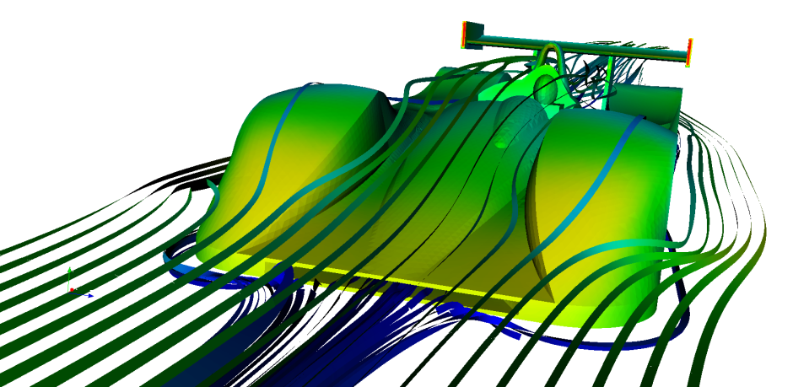
Open Source Visualization Tools
Visualization Toolkit (VTK)
C++ (5+M LOC), binding for Python, Java, TCL
Large community: Top 2%, 2500+ users
ParaView
Front-end to VTK
Parallel visualization
Qt-based
Scripting in Python
Open-Source (BSD)

Slide 8
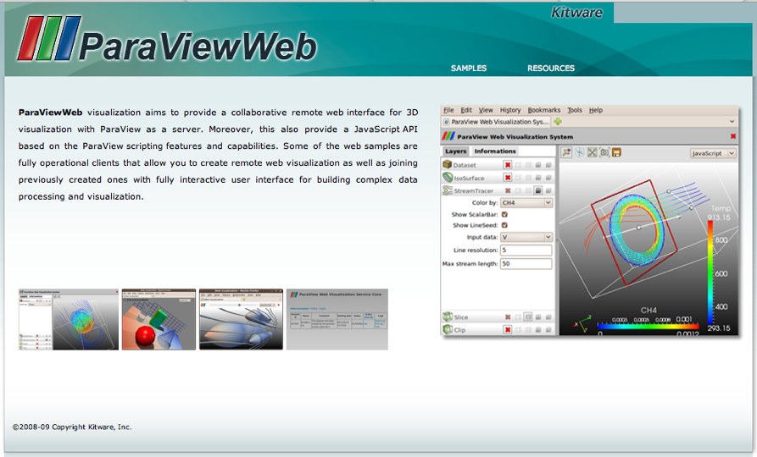
ParaViewWeb
It’s ParaView
Web Services
Interactive Viz Applets
JavaScript Visualization API
Adds Collaboration to Data Exploration
Multiple Clients can interact with the same visualization
ParaView.org

Slide 9
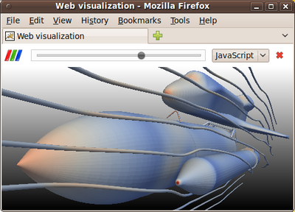
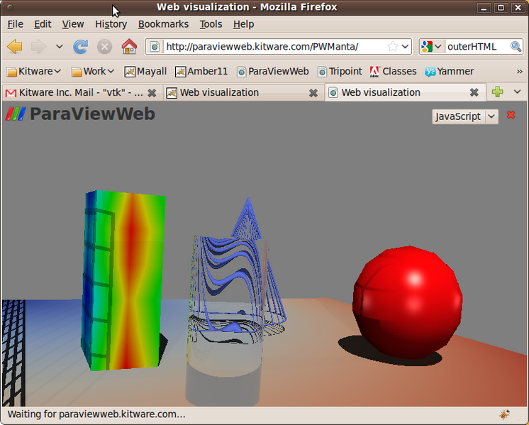
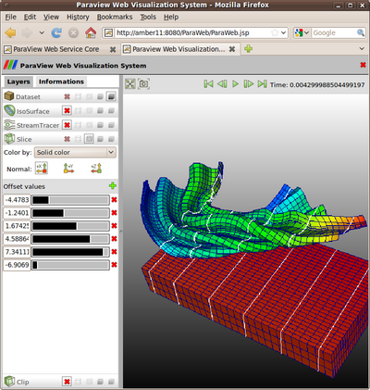
ParaViewWeb
http://www.webviz.org

Slide 10
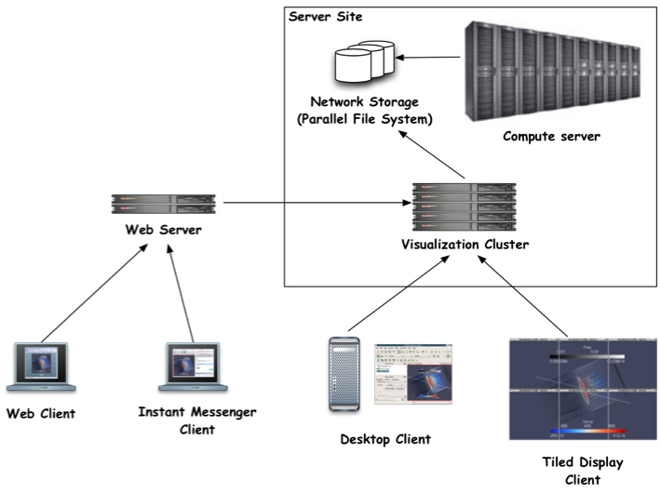
10
29

Slide 11
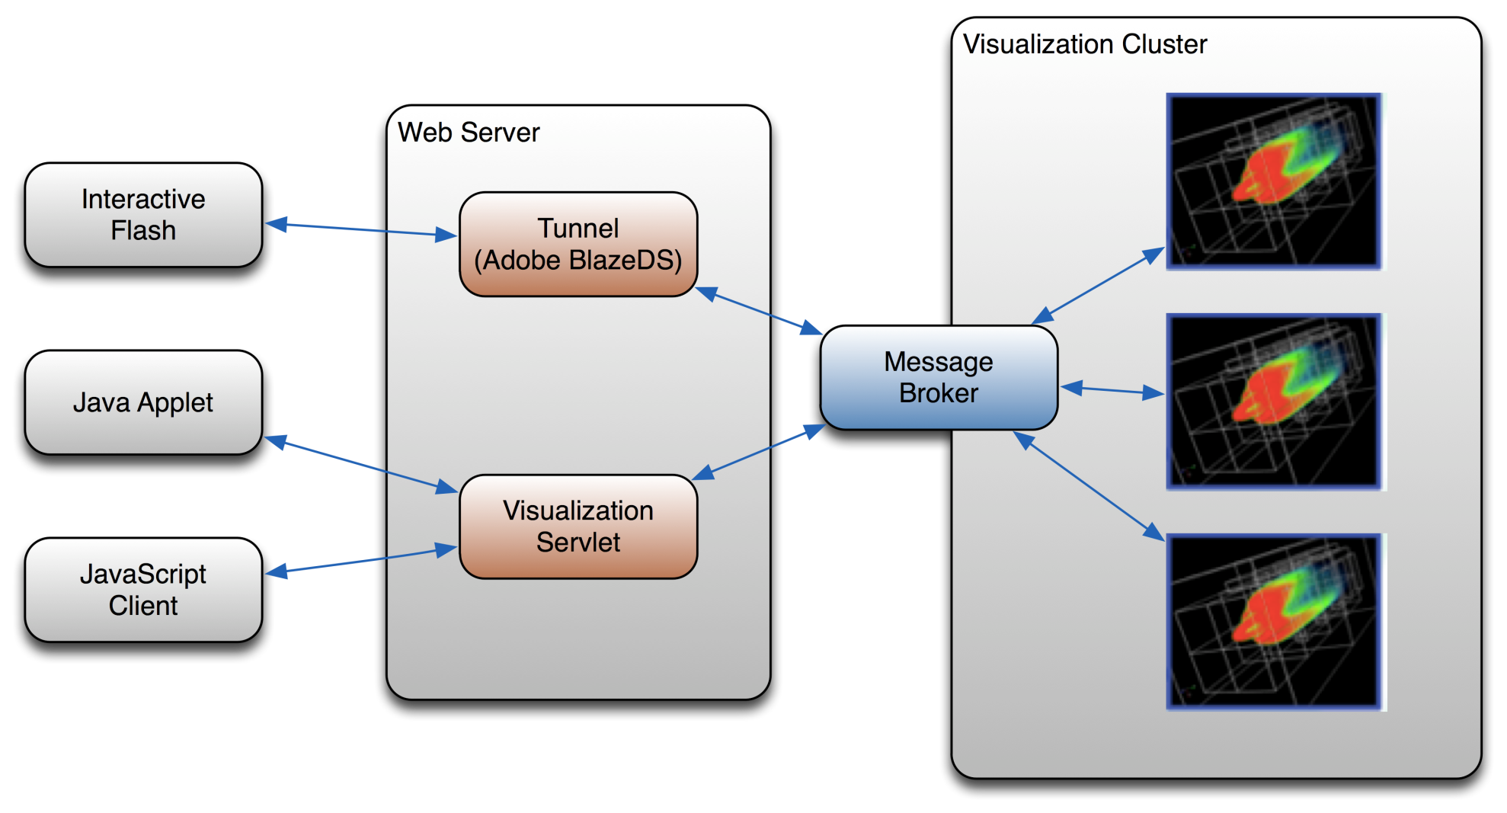
ParaView Web

Slide 12
Architecture
JavaScript library + Renderer (JS/Java/Flash)
Web service (JSON-RPC + HTTP)
Processing and Rendering engine
allow multi deployment configuration
(local, remote, distributed)

Slide 13
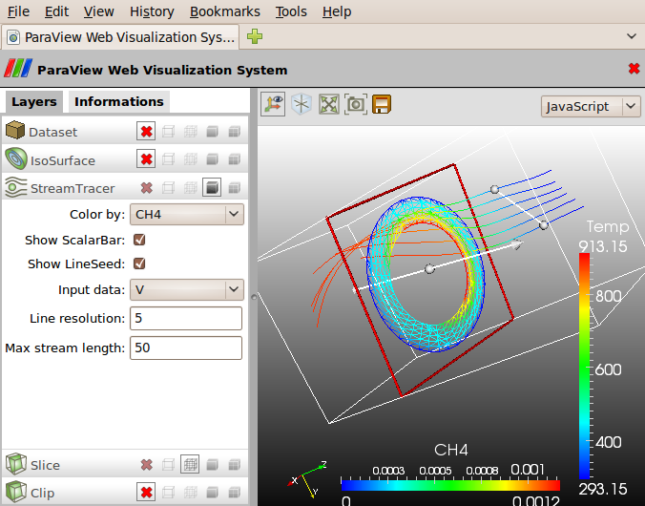
Scientific visualization

Slide 14
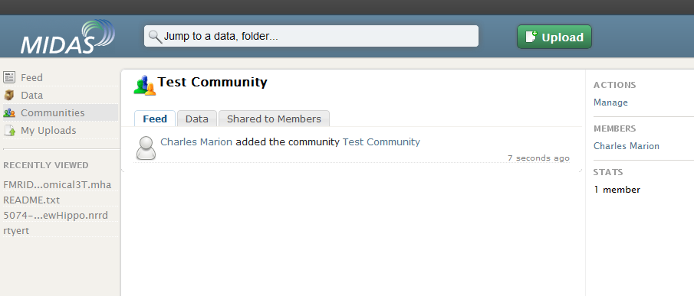
MIDAS
Web-based Multimedia Digital Archiving System
Store, search and manage digital media
Open Source (BSD)
Modular and highly customizable framework
Server side processing via distributed computing
Online visualization

Slide 15
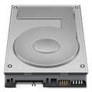
MIDAS Framework
Database:
PDO
NoSQL
Storage:
local
remote
Amazon S3
Processing:
local
Hadoop
Batchmake

Slide 16
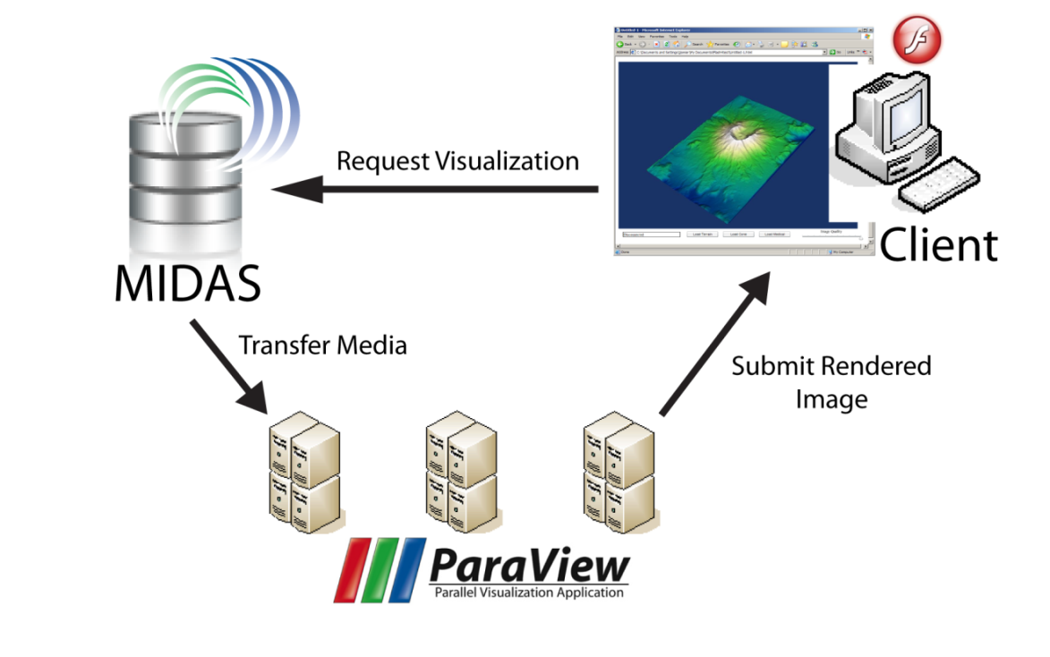
ParaViewWeb/MIDAS Integration

Slide 17
Integration Challenges
Data repository & Visualization clusters separated
Data (distributed)
Visualization (parallel)
Getting the data to the visualization cluster
Getting the data from the visualization cluster
Data can be heterogeneous
Size vs. Speed
Metadata is important for visualization

Slide 18
Integration Implementation
Driven from a central location (MIDAS)
Getting the data to the Visualization cluster
Standard network storage (NFS, AFS, Samba)
Remote protocol (FTP/Http)
Getting the rendered image to MIDAS
ParaViewWeb Javascript API
RESTFul API
Streaming/WebGL

Slide 19
Instant Visualization
Notes:
http://paraviewweb.kitware.com/PW/

Slide 20
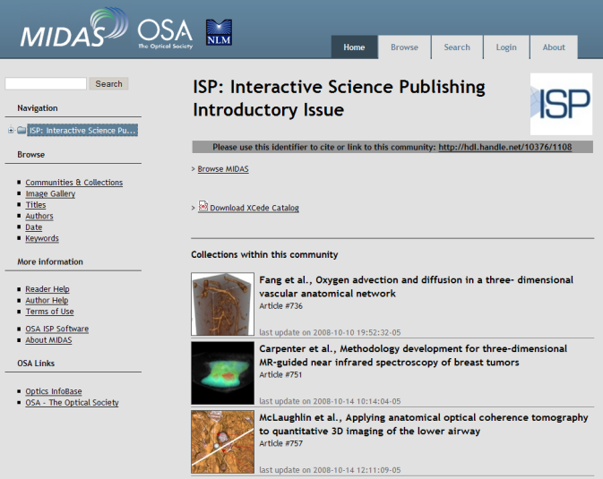
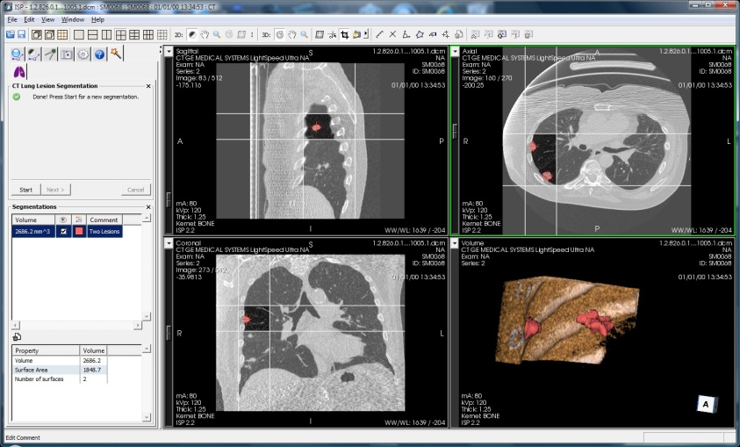
Interactive Science Publishing
Optical Society of America
Enhance traditional publishing with 3D rendering
Sponsored by the National Library of Medicine
Low-resolution < 10s
High-resolution = background
Open Datasets
http://midas.osa.org

Slide 21
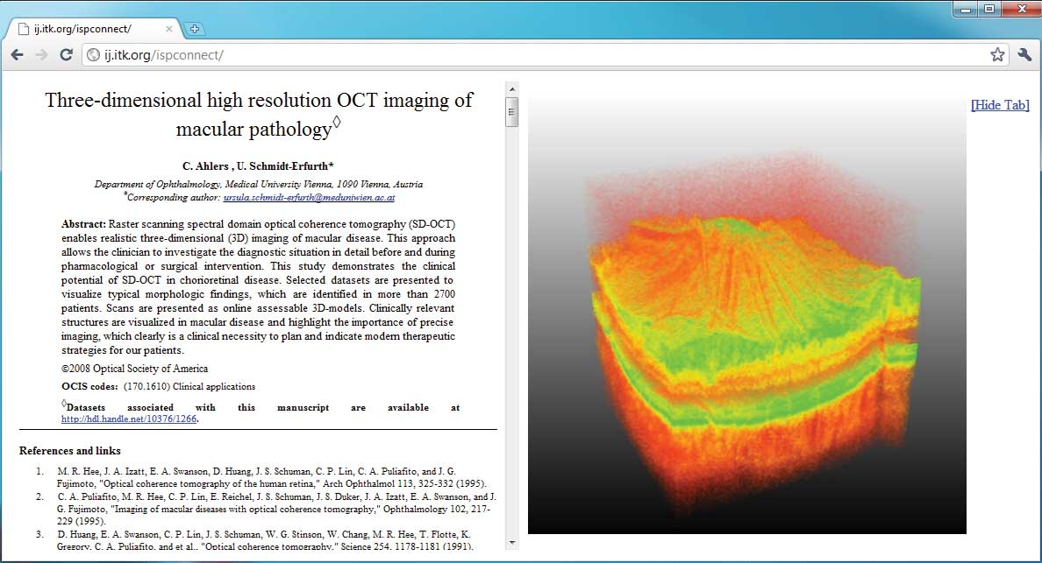
Interactive Science Publishing

Slide 22
Conclusion
Data management and visualization system
Hybrid visualization
Server-side processing
Analysis

Slide 23
Acknowledgments
Charles Marion
Sebastien Jourdain
Utkarsh Ayachit
DOE SBIR Phase II Award DE-FG02-08ER85143
NIH STTR Phase II Award 2R42NS059095-03

Slide 24
Remote Visualization of Large Datasets with MIDAS & ParaViewWeb Questions?
Julien Jomier, Kitware julien.jomier@kitware.com

